Slide 1
Law as code
Can we use Large Language Models (LLMs) to automatically transform natural language Swisslaw into verifiable, machine-executable code?

Slide 2
Definition / Objective
Selected Law
Process Diagram
Output
Outlook

Slide 3
Definition / Objective
Definition :
Law as Code (LaC) / Rules as Code (RaC) is the practice of translating existing legislation into machine-executable code, enabling automated and consistent application of legal rules.
Hence our Hypothesis :
Can we use Large Language Models (LLMs) to automatically transform natural language Swiss law into verifiable, machine-executable code?

Slide 4
Selected Law Texts
To proof our hypothesis, we choose the following recht guideline
ABG (Ausbildungsbeiträge Bern — Cantonal)
ABG Art. 1-16 — Stipendium Eligibility
ABG Art. 10/16 — Stipendium Amount
AHVG (Federal Old-Age Insurance)
Art. 3 — AHV Insurance Obligation
Art. 5 — AHV Employee Contribution
Art. 10 — AHV Self-Employed Contribution
OR (Code des Obligations)
Art. 41 — Tort Liability

Slide 5

Process Scheme

Slide 6
Output / Outlook

Slide 7
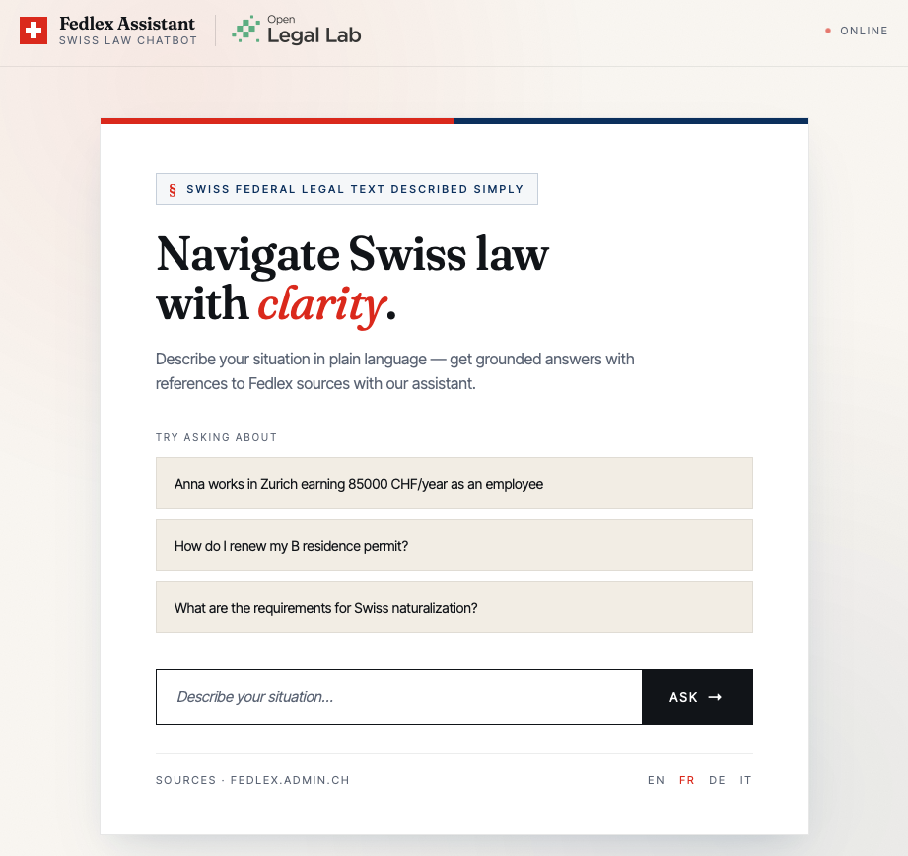
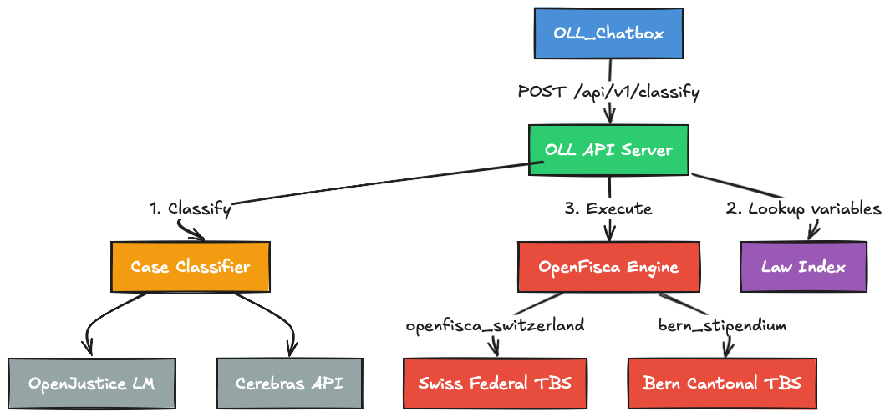
Output

Slide 8
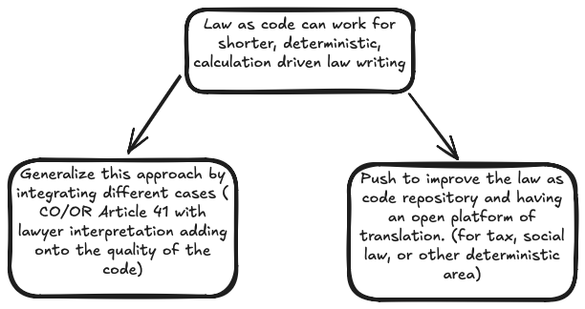
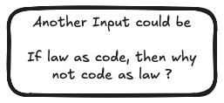
Outlook

